Slide 1

Jenkins Server Setup
A comprehensive guide to understanding, installing, and configuring Jenkins for your CI/CD pipeline

Slide 2
Agenda
1
2
Jenkins Architecture
Prerequisites
Understanding the Master-Agent model
Required software and system specifications
3
4
Installation Options
Setup & Configuration
Local, Docker, and cloud-based approaches
Initial wizard, dashboard tour, and security basics

Slide 3

Jenkins Architecture: Master-Agent Model
Jenkins follows a Master-Agent architecture that enables distributed builds and testing across multiple machines.
The Master coordinates jobs, schedules builds, and manages the UI
The Agents (formerly called slaves) execute the actual build tasks
This distributed approach allows for parallel execution and specialized build environments

Slide 4
Prerequisites for Jenkins Installation
Java Requirements
Version Control
System Requirements
Java 11 or Java 17 (LTS releases)
Git client installed
256MB RAM (minimum)
OpenJDK or Oracle JDK
Access to repositories
1GB+ RAM (recommended)
JAVA_HOME environment variable set
10GB+ disk space
Stable network connection
These requirements may vary based on your specific workload and the number of builds you plan to run simultaneously.

Slide 5
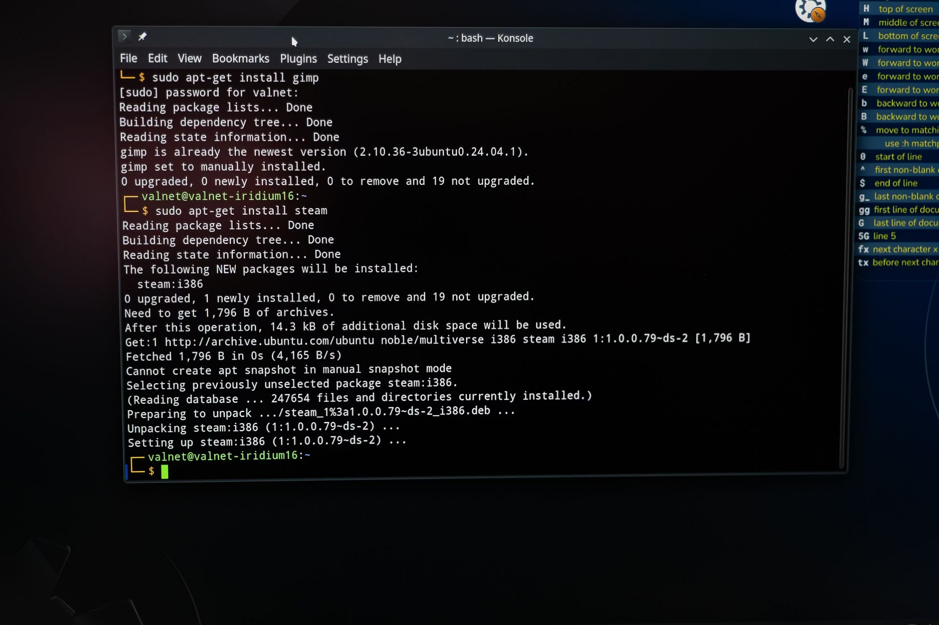
Installation Option 1: Local Installation
Platform-Specific Instructions
Jenkins can be installed directly on your operating system:
Linux: via package managers (apt, yum)
Windows: MSI installer or as a service
macOS: Homebrew or installer package
Best for: Development environments, small teams, or when you need direct access to local resources.

Slide 6
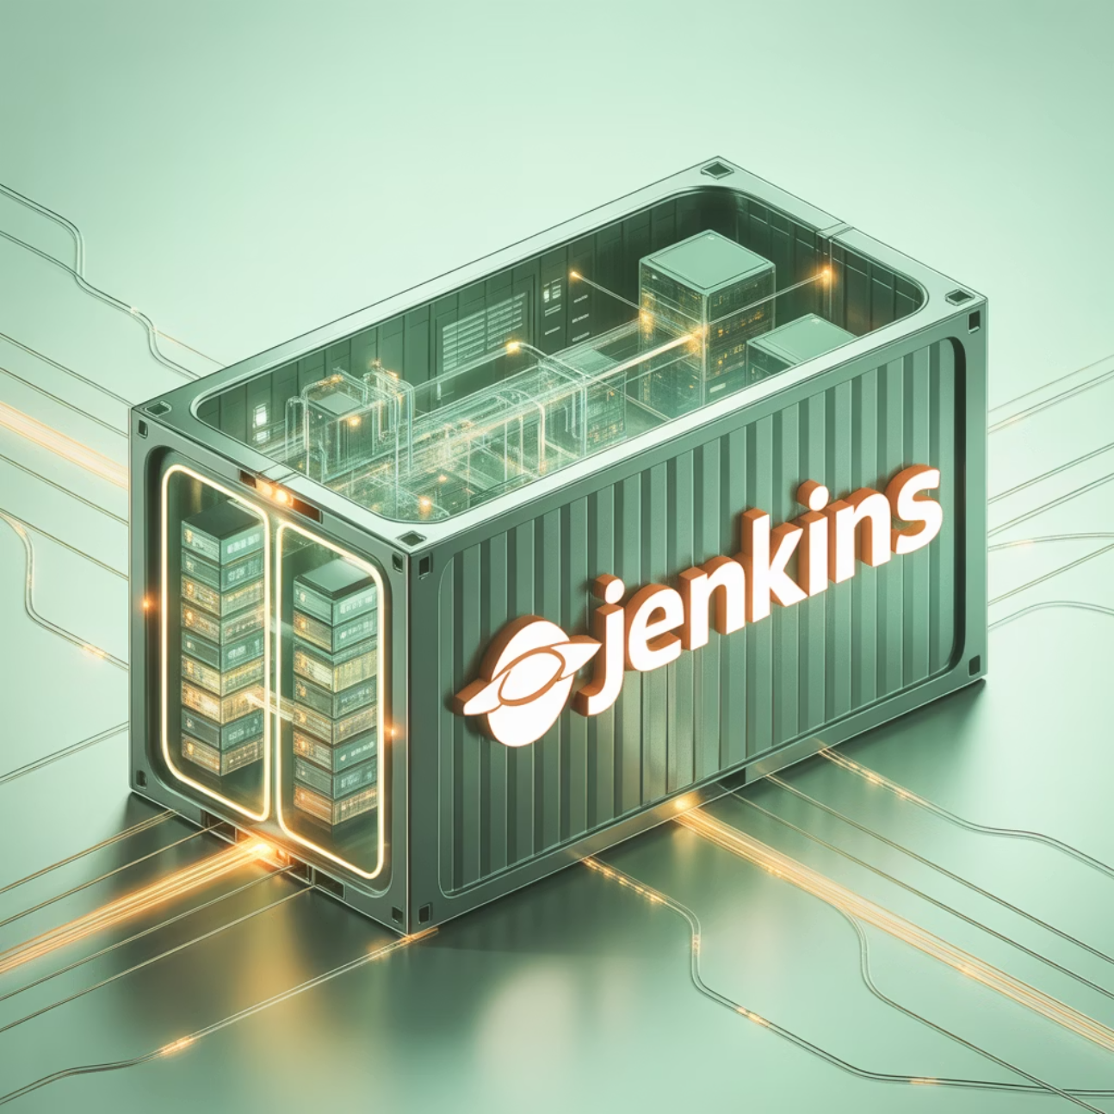
Installation Option 2: Dockerized Jenkins
Running Jenkins in Docker offers several advantages:
Consistent environment across different platforms
Easy upgrades and rollbacks
Isolation from the host system
Simple configuration via Docker Compose
Basic command to get started:
docker run -p 8080:8080 -p 50000:50000 \-v jenkins_home:/var/jenkins_home \jenkins/jenkins:lts

Slide 7
Installation Option 3: Cloud-Based Jenkins
AWS
Azure
GCP
EC2 instance with Jenkins AMI
Azure VM deployment
Compute Engine instances
Elastic Beanstalk deployment
Azure DevOps integration
Google Kubernetes Engine
Integration with AWS services
Managed identity support
Cloud Build integration
Cloud-based installations are ideal for teams requiring scalability, high availability, and integration with cloud-native services. They typically offer better performance for distributed teams.

Slide 8
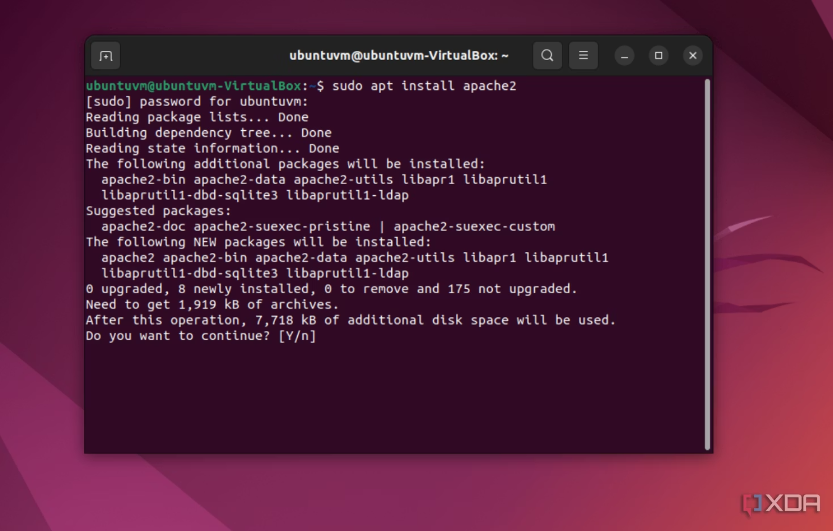
Hands-on Demo: Installation Process
We'll walk through a Linux-based installation as our example:
Update package repositories
Install Java: sudo apt install openjdk-11-jdk
Add Jenkins repository key
Add Jenkins repository to sources list
Install Jenkins: sudo apt install jenkins
Start Jenkins service: sudo systemctl start jenkins
Enable auto-start: sudo systemctl enable jenkins

Slide 9
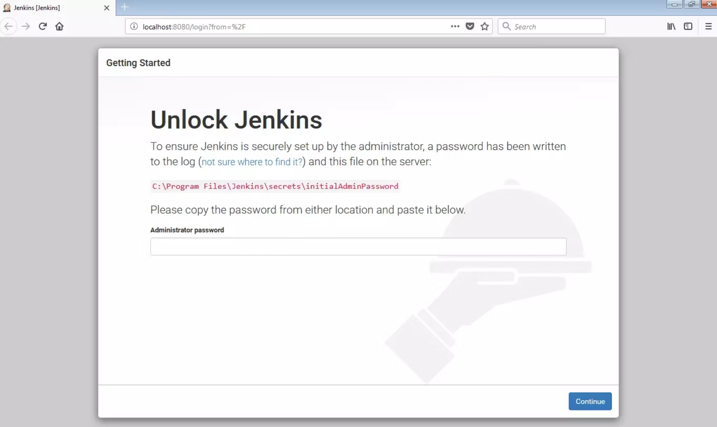
Initial Setup Wizard
After installation, Jenkins guides you through initial configuration:
Access Jenkins at http://localhost:8080
Retrieve the initial admin password from the specified file
Choose between "Install suggested plugins" or "Select plugins to install"
Wait for plugin installation to complete
Create your first admin user with secure credentials
Configure the Jenkins URL

Slide 10
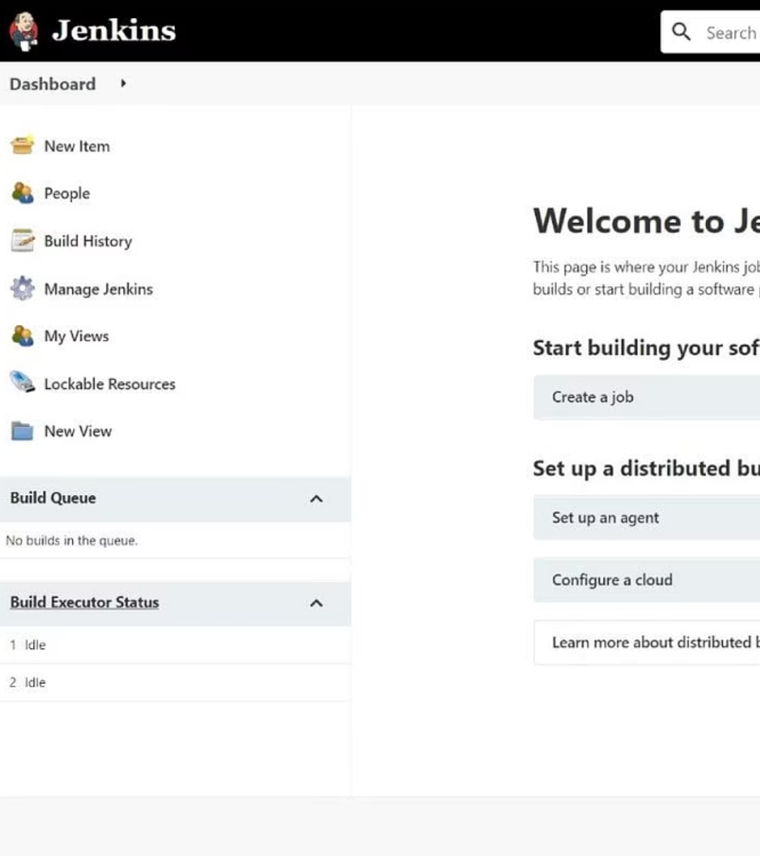
Jenkins Dashboard Tour
Main Dashboard Elements
The central hub displays job status, recent builds, and system health
Left Sidebar Navigation
Access to jobs, build history, credentials, and system configuration
Status Icons
Visual indicators show build status (success, failure, in progress)

Slide 11
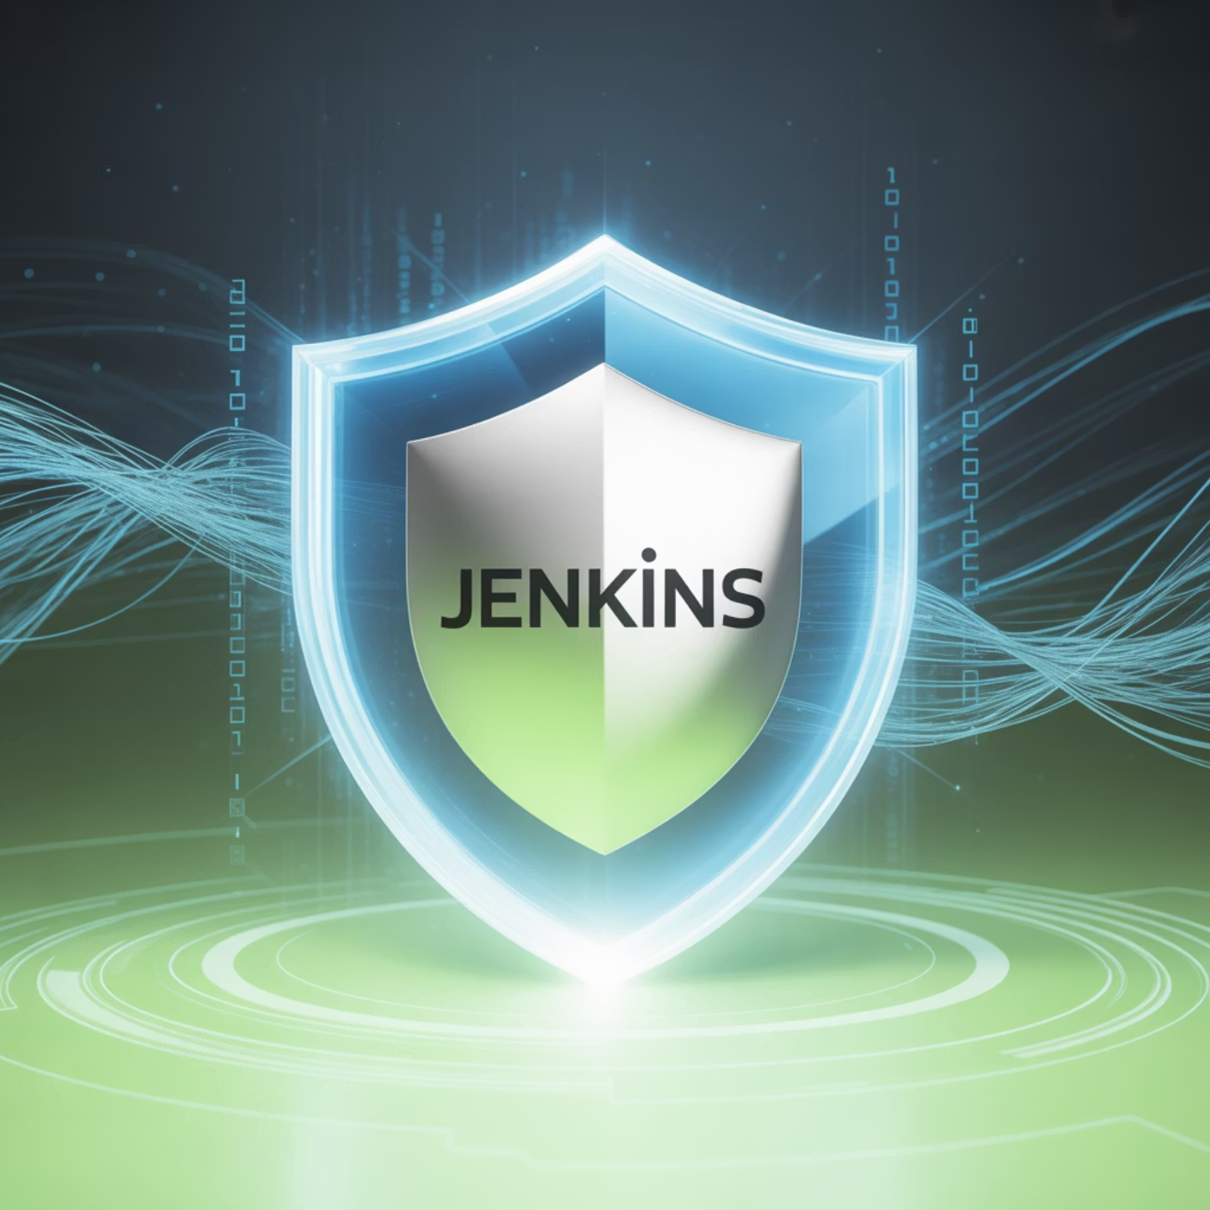
Security Basics
Admin Account Security
Use strong, unique passwords
Consider enabling 2FA with appropriate plugins
Regularly audit admin accounts
Role-Based Access Control
Install the "Role-based Authorization Strategy" plugin
Create roles with specific permissions
Assign users to appropriate roles
Implementing proper security measures is crucial for protecting your CI/CD pipeline and codebase.

Slide 12
Next Steps
Configure Your First Pipeline
Install Essential Plugins
Create a simple pipeline job to validate your Jenkins setup and understand the basics of pipeline syntax.
Extend Jenkins functionality with plugins for your specific tech stack and workflow needs.
Implement CI/CD Best Practices
Set Up Agents
Configure automated testing, deployment strategies, and notification systems.
Add build agents to distribute workload and support different environments for your builds.
Remember: Jenkins is highly customizable. Start with a minimal viable setup and expand as your needs grow.

Slide 13
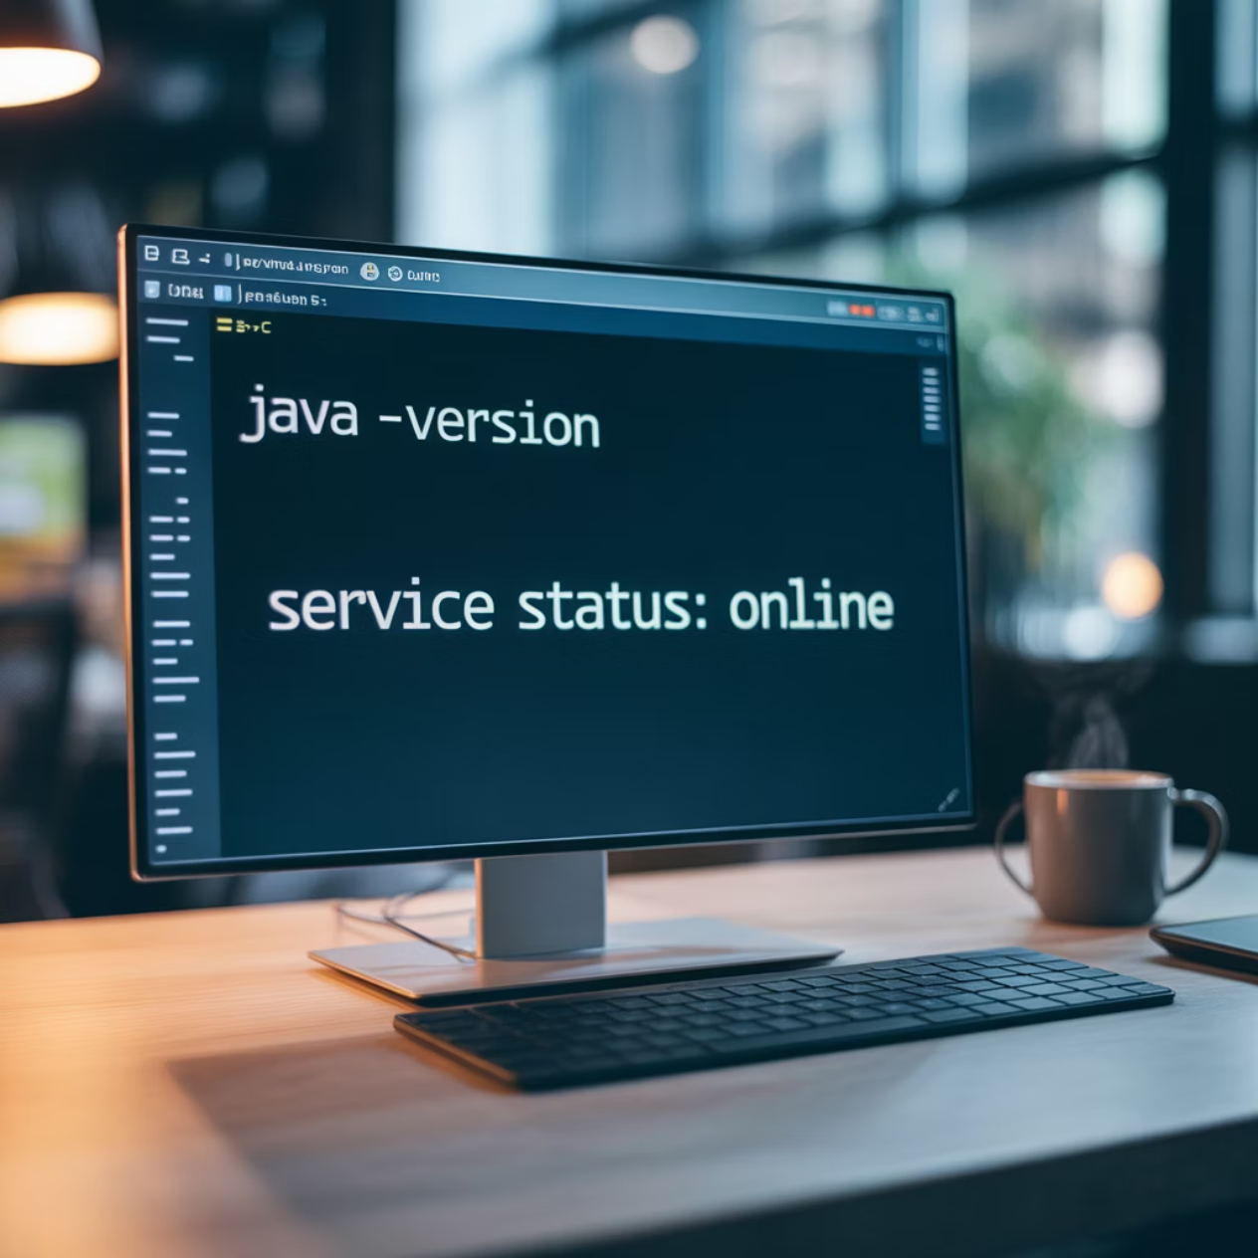
Post-Installation Checks
1. Environment Variable Configuration
Ensure your Java environment is correctly set up by configuring JAVA_HOME and updating your system's PATH variable. This is critical for Jenkins and any build tools that rely on Java.
JAVA_HOME points to your JDK installation directory.
Add %JAVA_HOME%/bin (Windows) or $JAVA_HOME/bin (Linux/macOS) to your PATH.
Restart your terminal or system for changes to take effect.
2. Verify Java and Jenkins Runtime
Confirm that Jenkins is using the correct Java version and is running as expected:
Check Java version: java -version
Verify Jenkins service status: sudo systemctl status jenkins (Linux)
Access the Jenkins web interface at http://localhost:8080 to ensure it loads correctly.
Proper environment setup prevents common issues and ensures a stable Jenkins operation.

